Slide 1
Board of Selectmen FY 23/24 Budget Recommendation
Presented to the Board of Finance
March 15, 2023
Prepared by Jason E. Bowsza, First Selectman

Slide 3
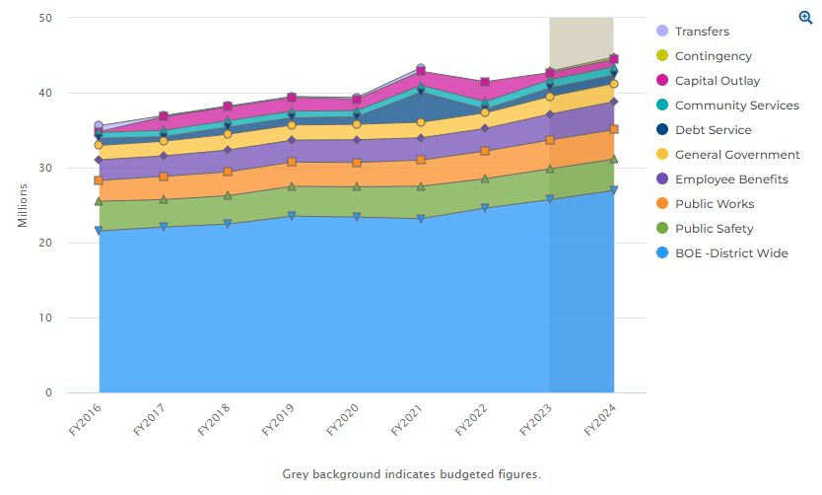
Multi-Year Trend by Department
Source: https://cleargov.com/connecticut/hartford/town/east-windsor/2024/native/expenditures?breakdowntype=department&objectid=2129763
Notes:
This shows where Total budget dollars have gone over time. The shaded area shows where budget dollars would go in the next fiscal year as presented by Dr. Tudryn and me.

Slide 4
Four Year Growth in the Grand List
Notes:
This data shows growth in our Grand List over time. Since I took office, the Grand List has grown by nearly $80 million, an 8% increase in taxable property (real property, personal property and motor vehicle). Those are apples to apples comparisons because they are all based off of the 2017 revaluation. As our tax base grows, that’s less of a burden on our existing taxpayers.

Slide 5
Total Budget Submission Distribution
Notes:
For the next Fiscal Year’s proposals, the distribution of appropriated funds is 60% for the Board of Education and 40% for Town Government. This is historically consistent with the distribution of local government funding in East Windsor, and it remains consistent in the proposals in front of you now.

Slide 6
Total Budget Recommendation Breakdown
Notes:
This slide shows the distribution of funds by cost center of where we are recommending funds be appropriated.

Slide 7
BOS FY 23/24 Town Gov't Breakdown
FY 23/24 Town Gov’t Breakdown
FY 22/23 Town Gov't Breakdown
Notes:
Now we’re going to look at where the dollars on the Town side of the budget are going. As you can see, the distribution of funds between cost center is pretty static from this year to next.

Slide 8
Total Year Over Year Breakdown by Function and Dollars
Notes:
This chart shows the proposed funding distribution by cost center in the Town government, relative to current year funding levels.

Slide 9
General Government
Notes:
The only change here between my initial recommendation to the board and their final one pertains to the registrars of voters. Their initial submission called for increased compensation for them, as well as the hiring of a part-time office worker (likely on a per diem basis). When the board sat down with them for their budget presentation, a number of questions arose and they were asked to review and reconsider their submission. When it was returned to us, the registrars were no longer in agreement with each other. As a result, the BOS did our best to put together a workable budget for them as best as we understood it, but you all should spend some time on this department in your deliberations.
Other areas of increase here include additional funding for the cemetery association, and increased LAP costs due to cyber security rate increases.
The Planning Department’s budget is being reduced by $8,793, largely due to the elimination of a currently vacant part-time clerk position.

Slide 10
Public Safety
Notes:
The reductions in the public safety departments are all in the Building Department, although that department is still increasing significantly over previous years. The request for the increases there covers the salary of the new building official, as well as increased funding for professional services, supplies, and dues and fees. Those functions had been pretty significantly underutilized until Ken was hired. I would also say that he is doing a great job catching up on issues in town that had gone ignored for years and years.
Otherwise, the requests from the police department, police commission, and communications departments are all put forward as submitted for your consideration.

Slide 11
Public Works
Notes:
Public Works consists of DPW, Town Property, Santitation, Road Improvements, and the Building Commission
Starting with DPW, you will notice increased funding in the full time salary line, reflective of the new split-funded position resulting from the MOA between the Town and the Board of Education for grounds maintenance. You will also notice that the BOE funding is offset in succeeding line. There are also savings incurred in the part-time salary line to make up the difference of the split-funded position.
Town Property is recommended to increase vehicle maintenance by $10,000, hydrants costs by $42,000, and oil and heat by $10,000. Electricity and streetlights are coming down.
Sanitation is going up by $53,000, the result of the contract that we have with USA Hauling. However, as costly as this line is, we are SUBSTANTIALLY better off in comparison to many other towns in terms of tipping fees.

Slide 12
Community Services
Notes:
Community Services consists of Senior Services, Social Services, Parks and Rec, the Elderly Commission, the Historic Commission, and libraries.
My initial recommendation to the board was to combine senior services, social services and parks and rec into one Community Services department, but I have since pulled that recommendation. The proposal in front of you keeps things status quo from an organizational perspective.
In Senior Services, the budget seeks to eliminate the funding of a part-time administrative assistant position and upgrade the Senior Center Nutrition Site Manager to full-time. That position is currently a 25-hour/week position. The upgrading of the position can be done administratively, and is likely to happen this fiscal year, but the funding transfer should be noted in the department budget, so it is included here.
While not a big dollar amount, we are seeking to increase the General Assistance line in the Social Services Department by $4,000. The Town has been trying to manage a number of displaced families over the last year and a half, with the displacements due to structure fires and condemnations. Under the federal Relocation Act, whenever a municipality declares a residence uninhabitable, the municipality is responsible for finding temporary housing for the displaced person or persons until they can find a similar place to live. “Similar” entails comparable accommodations at a comparable price. Under the federal law, the municipality is responsible for relocation costs in circumstances where the property owner cannot or will not cover relocation costs for the displaced tenants. In those circumstances, a lien is attached to the property that allows the municipality to recover relocation costs, although that may take years. Where this has proven to be problematic in the last two years is that there is no available housing stock in the price range which had been previously paid by the displaced families. As a result, the federal law has required the Town to assume the cost burden for these families over an extensive period of time.

Slide 13
Education
Notes:
Dr. Tudryn and his board can speak to their proposal, so I won’t go into too much detail here.

Slide 14
Debt Service
Notes:
Here we have a relatively significant change between last year, my initial proposed budget, and the recommendation of the Board of Selectmen. As you all will recall, in 2021 the Town paid off $3.5 million in long term debt. That added appropriation saved the Town hundreds of thousands of dollars in unaccrued interest, and still provided us access to significant bonding capacity in the event that we need to do additional long term borrowing.
What we are proposing is to relocated a portion of that now unencumbered debt service out of this department line and into CIP.

Slide 15
Capital Outlay
Notes:
By doing this, we’ll be able to contribute more funding to Capital Improvement projects, while keeping the funding available to be transferred back to Debt Service from CIP in out years when we are ready to bond. Relocating some of those debt service funds to this department also keeps it away from long term operating expenses (i.e. salaries and benefits.)

Slide 16
Benefits
Notes:
As the budget process moves along, benefits costs incurred by the Town come more sharply into focus. That is reflected here in the reductions noted between the initial department head request, my recommendation to the board, and the board’s final number. Much of the savings here are driven by health insurance premium renewals that are becoming more clear. At the start of the process, we were told to budget for an increase of 8-12%. Later, that renewal rate was narrowed to be between 8-10%. As of now, it looks most likely to be at 8%. As final numbers become available, they’ll be shared with you.
The other place where we saw savings here is in Workers’ Compensation. That budget was reduced by $40,000 based on historic trends.

Slide 17
Revenues
MV Supplemental: increase by $25,000 to $350,000
Aircraft fees: reduce by $500 to $3,800
Fund Balance: increase by $450,000 to $1,200,000
Building Department: increase by $50,000 to $300,000
Interest on Investments: increase by $75,000 to $100,000
Notes:
Amy and I also asked department heads about their revenue lines. This isn’t something that is done at the First Selectmen level or at the Board of Selectmen level, but a budget is made up of two parts (expenditures AND revenues) and so I wanted to include my revenue recommendations as well. After meeting with those department heads, we should increase our Motor Vehicle Supplemental by $25,000 to a total of $350,000, our Building Department fees by $50,000 to a total of $300,000, and our interest assumption to a total of $100,000. Each of these increases is supported by historical trends.
We should decrease our Aircraft fees revenue line by $500 to a total of $3,800.
The Town has also historically used our undesignated Fund Balance to offset property taxes to a degree. This lessens the tax burden that residents and businesses are asked to support. It is also the only way we can directly return the monies in the Undesignated Fund Balance to taxpayers. Because of the overall health of the Fund Balance, and in light of pressures that households continue to experience (from inflation to heating costs to electric costs and more), and in light of economic development that will bolster tax revenues next year and in future years, we are recommending that the Town use $1.2 million from the Fund Balance this year, up from $750,000. Again, this is the only way of returning a budget surplus back to the taxpayers.

Slide 18
Conclusion
The mill rate would go up by 0.11 mills, to 34.49*
$1,645,024 in new dollars
$1,023,366 for the Board of Education
$621,658 for Town government
A zero mill rate, and therefore no tax increase, can be achieved by reducing the budget submissions by $123,000 total
*assumes no additional changes to expenditures or revenues as presented
Notes:
Assuming no additional changes to the expenditure requests from the Board of Selectmen or Board of Education, and assuming that the revenue recommendations we are putting forward are included, the mill rate would go up by 0.11 mills to 34.49 mills (lower than any year since I took office except for the current year.)
For the Town Government, the request is for an additional $621,658. Breaking that down, $215,000 of that is tied to increased benefit costs, $98,000 of the request is tied to non-negotiated wages. We have three contracts that are in negotiations as of now, with assumed contractual obligations comprising the increase in this line.
One other note on benefits: We are at the high end of the 27th payroll in this coming budget cycle. While that pushes things upward a bit in this proposal, it will also lead to some significant relief in benefit costs next year.

Slide 19
Thank You
Members of the Board of Selectmen
Town Department Heads
Special Thanks to Amy O’Toole
Notes:
Finally, I would like to end with a number of thank yous
First, to the members of the Board of Selectmen, who over the last four years have each approached the budget-making process with the very best intentions of the Town in mind. Their collective collaboration has brought the Town to a much better place, and I’m grateful to each of them for their teamwork.
I also want to thank our Town department heads, who all worked hard to bring their budgets in line with the goals set forth by the Board of Selectmen and Board of Finance. They’ve put together reasonable proposals that keep costs low without compromising needed services. I thank them for their continued hard work and dedication.
And finally, as always, the final product of our town budget is largely due to the skills and vision that Amy O’Toole brings to the process. I appreciate her very much.

Slide 20
Any Questions?

