Slide 1


A DIVISION OF WELLSPARK
Health Enhancement Program
(HEP)
Notes:
Hello and welcome to the State of Connecticut Health Enhancement program. This is an overview of the program and will explain what requirements you will have to do to be compliant and the financial benefits that the program offers.

Slide 2



Welcome to the State of Connecticut Health Enhancement Program
Care Management Solutions Inc. (CMSI), a division of WellSpark administers HEP for the State of Connecticut Employees and Municipalities that join the partnership plan.
Purpose of HEP
To positively impact the overall health of its participants through two components: Preventive Requirements and Chronic Condition Education and Counseling
+
+
Notes:
Care management solutions is the company that administers the HEP program and we are located in Farmington, CT. The purpose of this program is to positively impact you and your colleagues overall health, through keeping up with preventive visits and chronic condition education and counseling if necessary.

Slide 3
How HEP Works
All requirements and chronic condition education are measured per calendar year
Preventive requirements are determined by age and gender
Chronic conditions are determined through claims and medication history on an individual basis
All requirements (preventive and chronic education) are to be completed by December 31 of each year
If you have joined HEP at any time after January 1st of the current year, you will have until the end of the following year to complete your requirements
Notes:
All preventive requirements and chronic condition education are measured per calendar year, with the look back period being the end of the year.
Your preventive requirements will depend on your age and gender and chronic conditions will be identified through claims and medication history per individual. The 7 chronic conditions HEP tracks are High blood pressure, high cholesterol, asthma, COPD, Heart Failure, Coronary artery disease (CAD) and diabetes.
All requirements must be completed by the end of each year, December 31.
If you are new to the program and have joined after January first of the current year, you will not have to get these requirements done until December 31 of the following year.
Example: If you joined on February 1st of 2018, you do not have to complete your requirements until December 31, 2018.

Slide 4
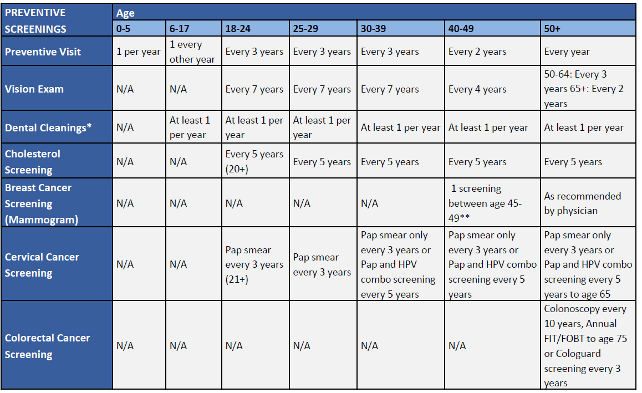
Preventive Requirements
Notes:
This is the preventive requirements grid which is used to determine what you will need to do for the year. Find your requirements column according to the age your were on January 1st and this will tell you what you need to do to comply with the HEP program.
*This grid is the minimum requirements to stay in our program it is not to be confused with your insurance benefits. Example: For the 30-39 age group you are only required to complete a physical every 3 years but you are covered by your insurance for one every year.

Slide 5
Chronic Condition Education and Counseling
The HEP program requires participants who have been identified with one or more of the following chronic conditions to complete annual educational requirements related to their disease, as well as accept a call from a CMSI registered nurse if one should reach out:
  Diabetes (Type 1 or 2)
  Asthma
  COPD
  Heart Disease/Heart Failure
  Hyperlipidemia
  Hypertension
All educational materials can be found at CTHEP.com
Notes:
If you are diagnosed with one or more of the 7 chronic conditions, each year you are required to either read educational materials or take a survey about each condition, and also accept a call from a Care Management Solutions nurse if one should reach out to you. All educational materials can be found at CTHEP.com and the survey can be taken online through the participant portal or over the phone with one of our customer service representatives.

Slide 6
Benefits of HEP
HEP does not only benefit your health, it also rewards employees and their dependents with a number of financial benefits by remaining compliant with the program:
  Lower premium payments – Non-HEP employees pay an additional $100 per month in premium
  Lower out-of-pocket expenses – Non-HEP employees pay annual $350 individual/$1,400 family in-network medical deductible
  Office visit co-pays are waived for anything related to the chronic conditions
  Lower to $0 co-pays for medications used to treat any of the chronic conditions mentioned earlier
Notes:
There are many benefits when you comply with the HEP program
You will have lower premium payments
Lower out of pocket expenses
Waived office visit co-pays-related to your chronic condition
And Low to $0 co-pays for medications used to treat chronic conditions.

Slide 7

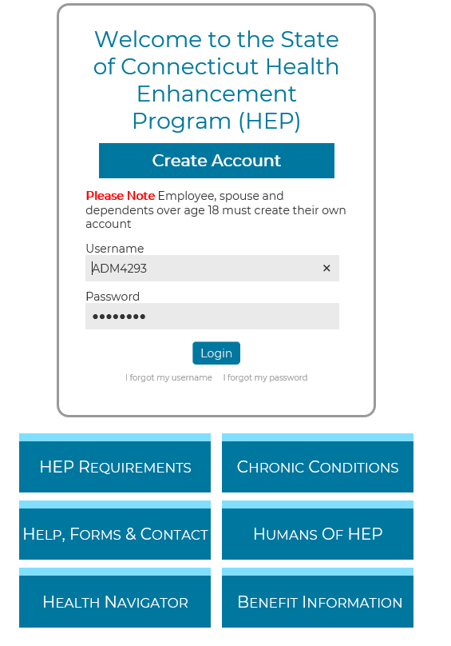
Register Online
Online portal access will be available approximately two months after your effective date
You can access information using the links below the login screen before you register
Register at CTHEP.com
Notes:
You will have access to the online portal approximately one month after your effective date on the plan. You can access information about the program using the links below the login screen when you go to CTHEP.com shown here. The options are HEP requirements, Help and Forms, Schedule a Physical, Chronic conditions, Contact and Enrollment Info.

Slide 8
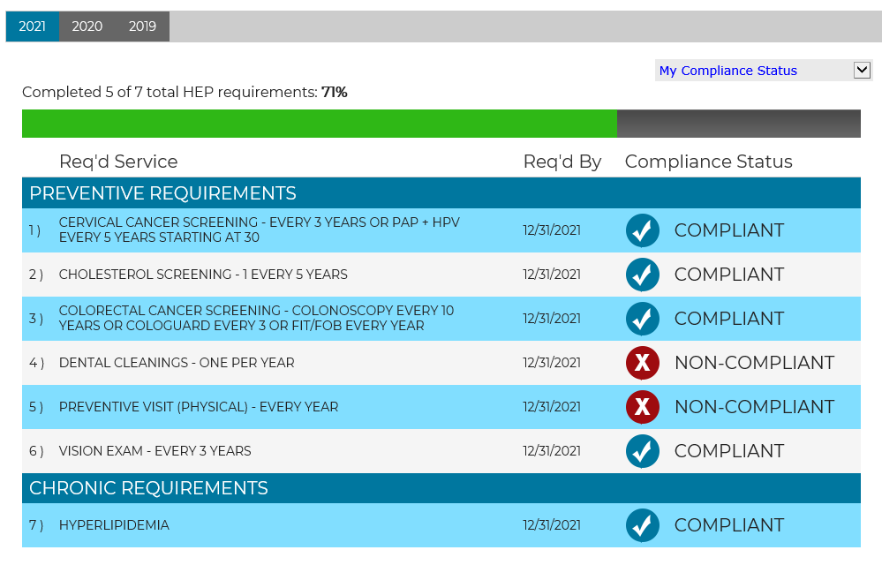
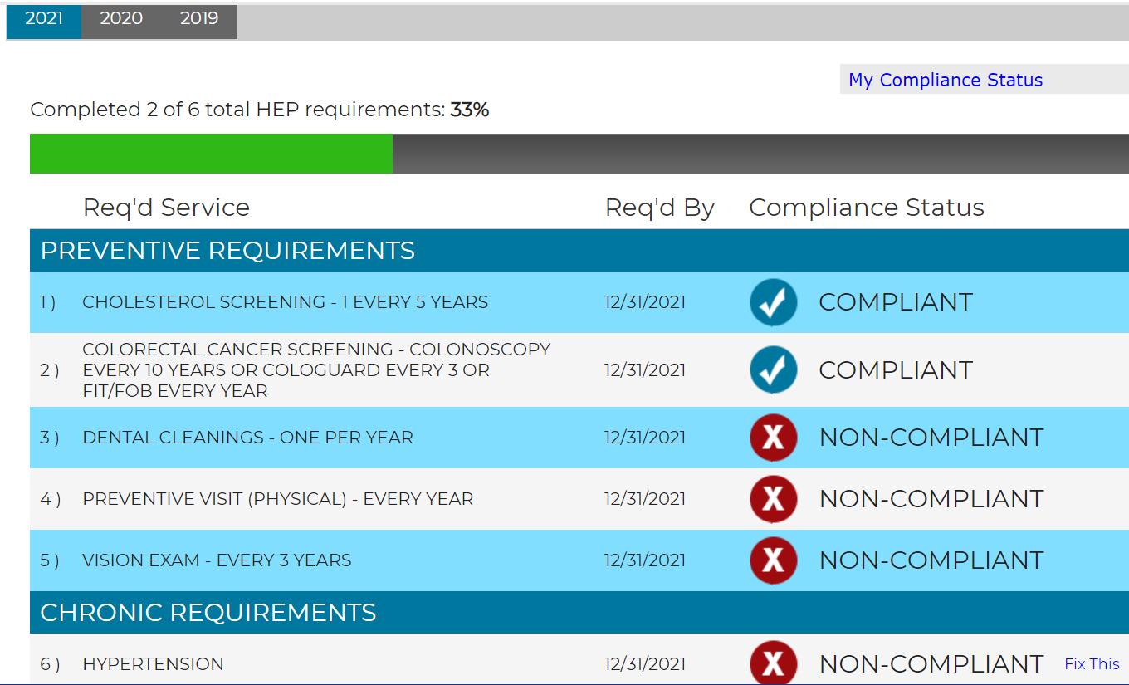
View Your Personal Requirements via the Web Portal
Once registered, you can:
Check your compliance status
Click on the “My Compliance Status” drop-down to check your family status
If identified with a chronic condition, click “fix this” to take a 5 question survey or read a fact sheet to complete the requirement online
Notes:
Once you have registered you can check your compliance status online and also your family’s compliance status using the dropdown in the right hand corner. You can also fulfill your chronic condition requirements by clicking the “fix this” link next to it if you have one

Slide 9
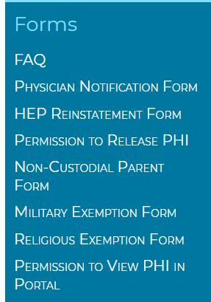
Help, Forms & Contacts
Under Help, Forms & Contacts you can locate our most commonly used forms. The Physician Notification Form should be used when a service was preformed prior to joining your new plan.
Please have your physician fill it out and you can fax it back to us - 1.855.207.1640.
We have added an FAQ document on the program with many helpful resources, should you have any questions
Notes:
When you select the Help, Forms & Contacts option you will find all contact information for our program along with the Physician Notification Form. This form is used when you had a service with a multi year requirement that you had fulfilled under a different insurance carrier and you want it to count for our program. For example: If you are in the 50+ age group and had a colonoscopy done two years ago under a different carrier; you can have your PCP fill out and sign the form with the date of the service. Once received; we will update the portal and you won’t have to go again until it reaches ten years from the service date completed.

Slide 10



Questions or Concerns?
Contact our call center to receive guided support at 1.877.687.1448 Monday-Thursday 8am – 6pm and Friday 8am – 5pm
You can also contact a customer service representative via email at HEPQuestions@Connect2YourHealth.com.
Fax number: 855-207-1640
You can log onto CTHEP.com and register 60 days from your insurance effective date
Notes:
If you have any questions you can contact our customer call center Mon-Thurs 8am-6pm and Friday 8am-5pm using our toll free number, 1-877-687-1448. You can also email a customer service representative any time at HEPquestions@connect2yourhealth.com.
Thank you and we look forward to working with you on improving and maintaining your health!

